Slide 1
BFX-AT100 TV screen shake
FA Report
Prepared by : PE Long
Date : 2023/06/16

Slide 2
#1
Problems description -1
Issue Description ( 5W2H)
When | 2023/05/27
Who | ALT customer
Where | SK networks warehouse, Anseong, Korea.
What | ALT customer feedback that they found out 1/1000pcs has TV screen shake. Defect rate: 1/1000 = 1000 DPPM
Why | Suspect SoC material (P/N: 002.02753.005. DC: 2223, Vendor: AMLOGIC)
How | TV screen shake
How many | Total 1pcs (Defect rate: 1/1000 = 1000 DPPM) as below table.
No | Description Issue | S/N | MAC | Fail rate
1 | TV screen shake | 2149688001202301080266 | BCF4D4F82447 | 1000 DPPM
Notes:
MA5800-X7#display cable modem <MAC> detail

Slide 3
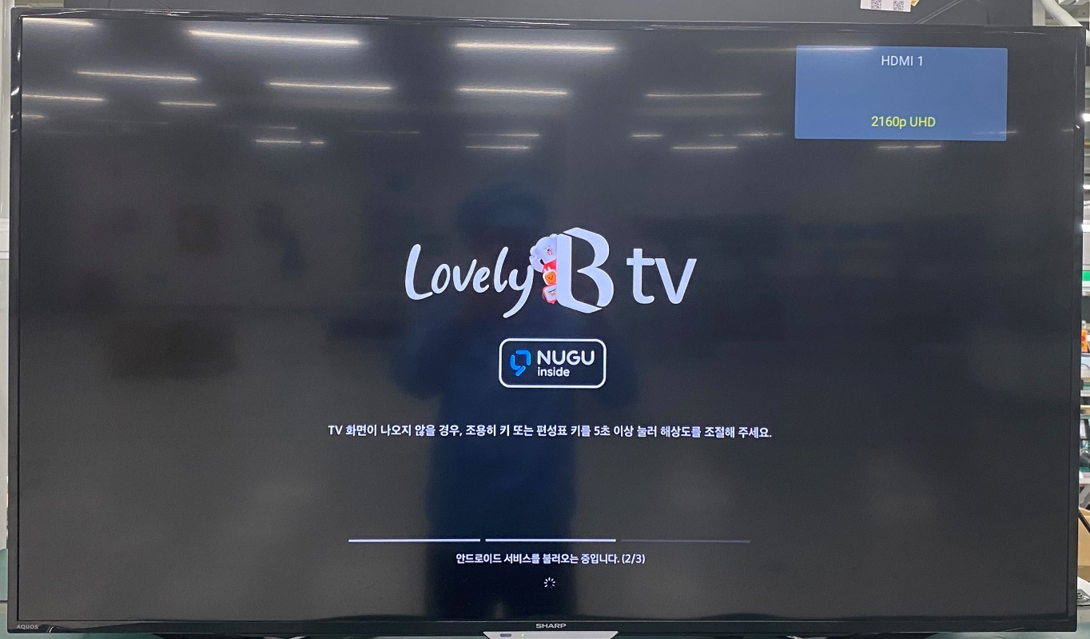
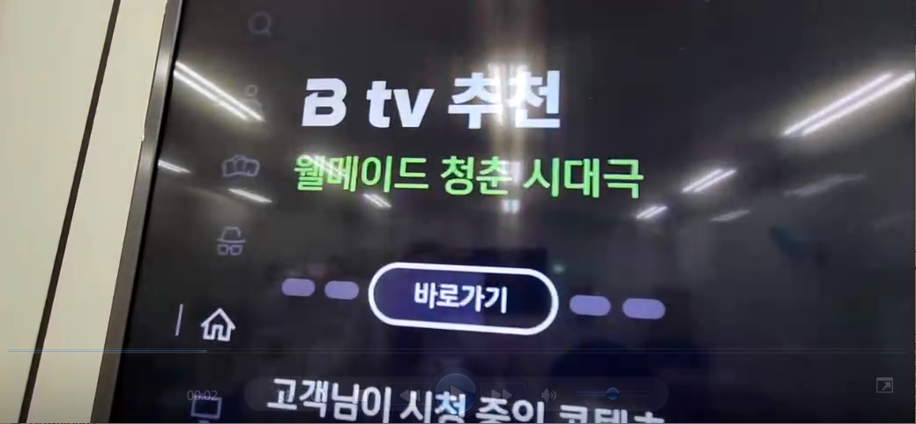
#2
Problems description -2
TV screen shake pictures
Notes:
MA5800-X7#display cable modem <MAC> detail

Slide 4
#3
Containment
Recheck production data record.
- This unit passed all station normally, no found any abnormal.
2. Recheck test log
No# | Station | Status
1 | UK | PASS
2 | FT (test HDMI video noise) | PASS
3 | FT1(test HDMI ) | PASS
4 | RC | PASS
5 | RC1 | PASS
6 | RC2 | PASS
Summary:
- Recheck production data record and test log ➔ Did not find out any abnormal.
Notes:
MA5800-X7#display cable modem <MAC> detail

Slide 5

#4
Root Cause: Retest OBA + FATP
1. Upgrade again factory FW and retest NG sample at FT, FT1 station, the result as below:
No. | Station | Result
1 | FT | Pass
2 | FT1 | Pass
2. Retest NG sample at OBA station.
TV screen shake at OBA station
Summary: The fail symptom same as customer feedback and FATP station can’t cover this issue.
Notes:
MA5800-X7#display cable modem <MAC> detail

Slide 6
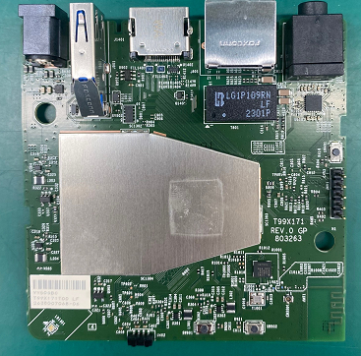
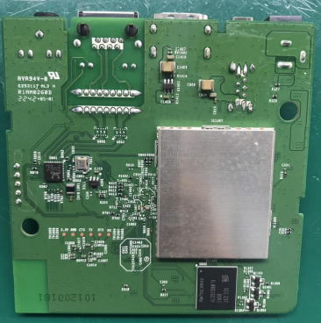
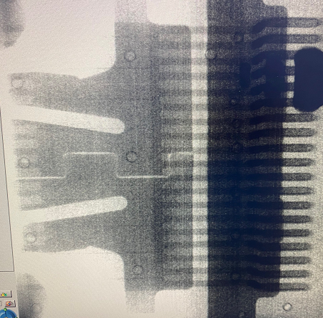

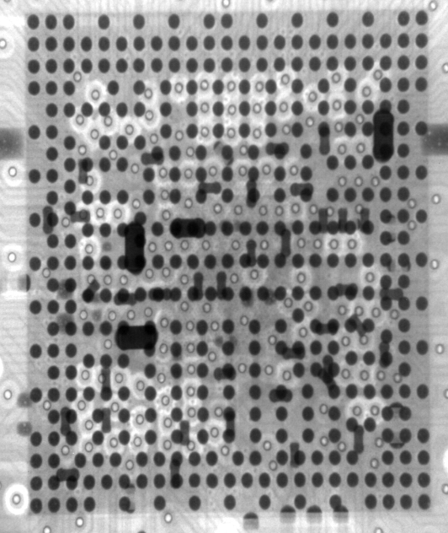
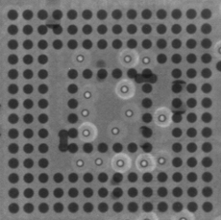
#4
Root Cause: Visual Inspection and Take X-ray
3. Check Visual inspection and take X-ray NG sample, result as below:
Item | Top side | Bottom side | Result
Visual inspection |  |  | No abnormality
Item | SoC | eMMC | HDMI Connector | Filter | Result
X-ray |  |  |  |  | No abnormality
Summary:
- Check visual inspection and take X-ray ➔ Result: No abnormality
Notes:
MA5800-X7#display cable modem <MAC> detail

Slide 7
#4
Root Cause: Impedance/VF Measurement
4. Measure impedance /VF on board HDMI connector of NG sample and compare with OK sample, result as table below:
Impedance/VF measurement on board HDMI Connector
Pin No | Pin Name | Description | NG sample |  | OK sample
 |  |  | Impedance (Ω) | VF | Impedance (Ω) | VF
1 | TX2+ | HDMI TMDS data2 negative output | 3.15M | 0.68 | 3.2M | 0.68
2 | TX2_shield | System Ground | 0 | 0 | 0 | 0
3 | TX2- | HDMI TMDS data2 positive output | 3.15M | 0.67 | 3.2M | 0.68
4 | TX1+ | HDMI TMDS data1 positive output | 3.15M | 0.67 | 3.2M | 0.68
5 | TX1_shield | System Ground | 0 | 0 | 0 | 0
6 | TX1- | HDMI TMDS data1 negative output | 3.15M | 0.64 | 3.2M | 0.68
7 | TX0+ | HDMI TMDS data0 positive output | 3.15M | 0.68 | 3.2M | 0.68
8 | TX0_shield | System Ground | 0 | 0 | 0 | 0
9 | TX0- | HDMI TMDS data0 negative output | 3.15M | 0.67 | 3.2M | 0.68
10 | TXC+ | HDMI TMDS clock positive output | 3.15M | 0.67 | 3.2M | 0.68
11 | TXC_shield | System Ground | 0 | 0 | 0 | 0
12 | TXC- | HDMI TMDS clock negative output | 3.1M | 0.68 | 3.2M | 0.68
13 | CEC | General purpose input/output bank H signal 3 | 2.0M | 0.69 | 2.2M | 0.69
14 | NC | Not Connect | NA | NA | NA | NA
15 | SCL | General purpose input/output bank H signal 1 | 1.03M | 0.6 | 1.2M | 0.62
16 | SDA | General purpose input/output bank H signal 0 | 1M | 0.6 | 1.01M | 0.61
17 | GND | System Ground | 0 | 0 | 0 | 0
18 | 5V | HDMI_PW | 1.0M | 0.49 | 1.2M | 0.55
19 | HPD | General purpose input/output bank H signal 2 | 109.6K | 0.69 | 110K | 0.69
Summary: Did not find out abnormal with impedance of NG sample
Notes:
MA5800-X7#display cable modem <MAC> detail

Slide 8
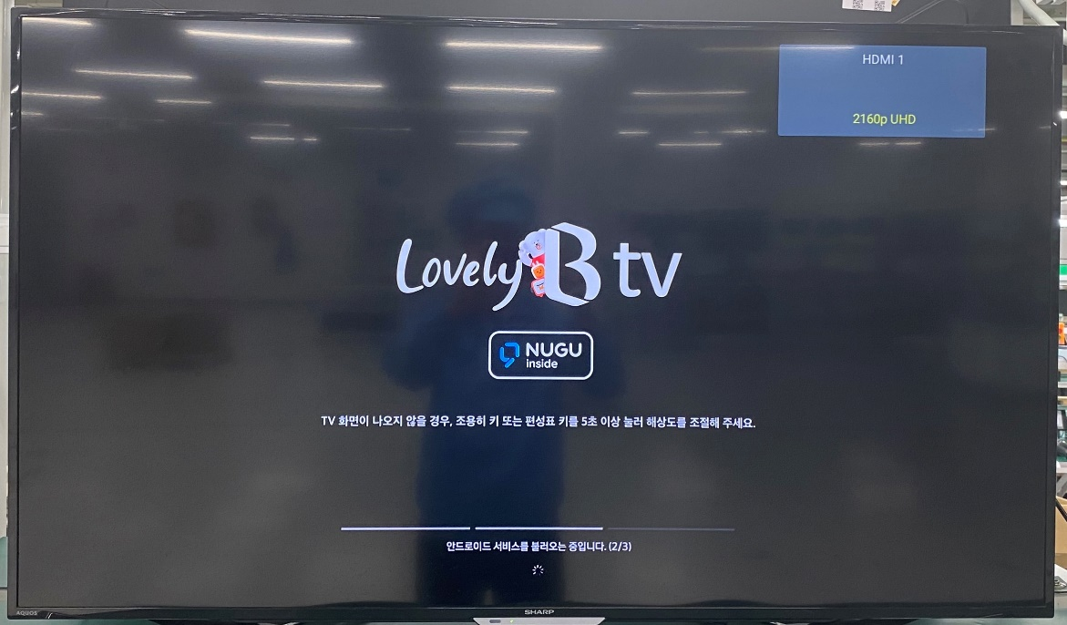
#4
Root Cause: Change Component of HDMI Block
5. Change component of HDMI block:
- Change new FIL1401, FIL1402, J1401 then retest screen TV at OBA.
Result: Fail
TV screen shake
Summary: After change new FIL1401, FIL1402, J1401 then retest Screen TV at OBA , result: screen TV still (logo booting, video) shakes.
=> Suspect SoC (P/N: 002.02753.005. DC: 2223. Vendor: AMLOGIC) has issue.
Notes:
MA5800-X7#display cable modem <MAC> detail

Slide 9
#4
Root Cause
Conclusion:
- Occur cause: Suspect material issue, SoC (P/N: 002.02753.005, DC: 2223, Vendor: AMLOGIC), waiting confirmation from customer can change new SoC or not for further analysis.
- Escape cause: FATP can’t cover issue.
Notes:
MA5800-X7#display cable modem <MAC> detail

Slide 10
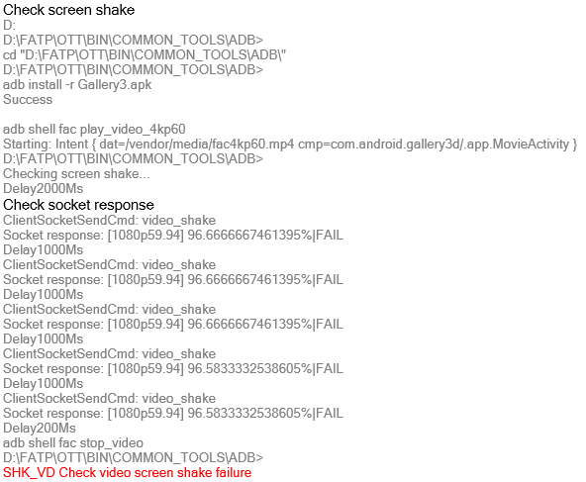
#5
Action
- RD improves the test program at FT1 station to cover screen shake issue.
(Done, RD Jerry improved test program and sent to factory for verification)
- TE Jones used NG unit which detected by customer to verify new test program 5time, result as table below:
Test times | Result
1 | SHK_VD Check video screen shake failure
2 | SHK_VD Check video screen shake failure
3 | SHK_VD Check video screen shake failure
4 | SHK_VD Check video screen shake failure
5 | SHK_VD Check video screen shake failure
Verification result
SHK_VD Check video screen shake failure at FT1 station
Summary: As the verification result, new test program can cover screen shake issue. Therefore, Fii applies new test program into production to cover this issue. (Owner: TE Jones , Done).
Notes:
MA5800-X7#display cable modem <MAC> detail

